Slide 1


Ch 14 : Workplace quality measures
Class 10
Bhavan Shankar
X-e

Slide 2

introduction
In any organisation it is necessary to maintain a good air quality to improve the working capabilities of employees.
A pollution free air is an essential requirement for any organisation .
Water pollution is another problem faced by many organisations.
So an organisation must ensure to prevent air pollution or water pollution.

Slide 3
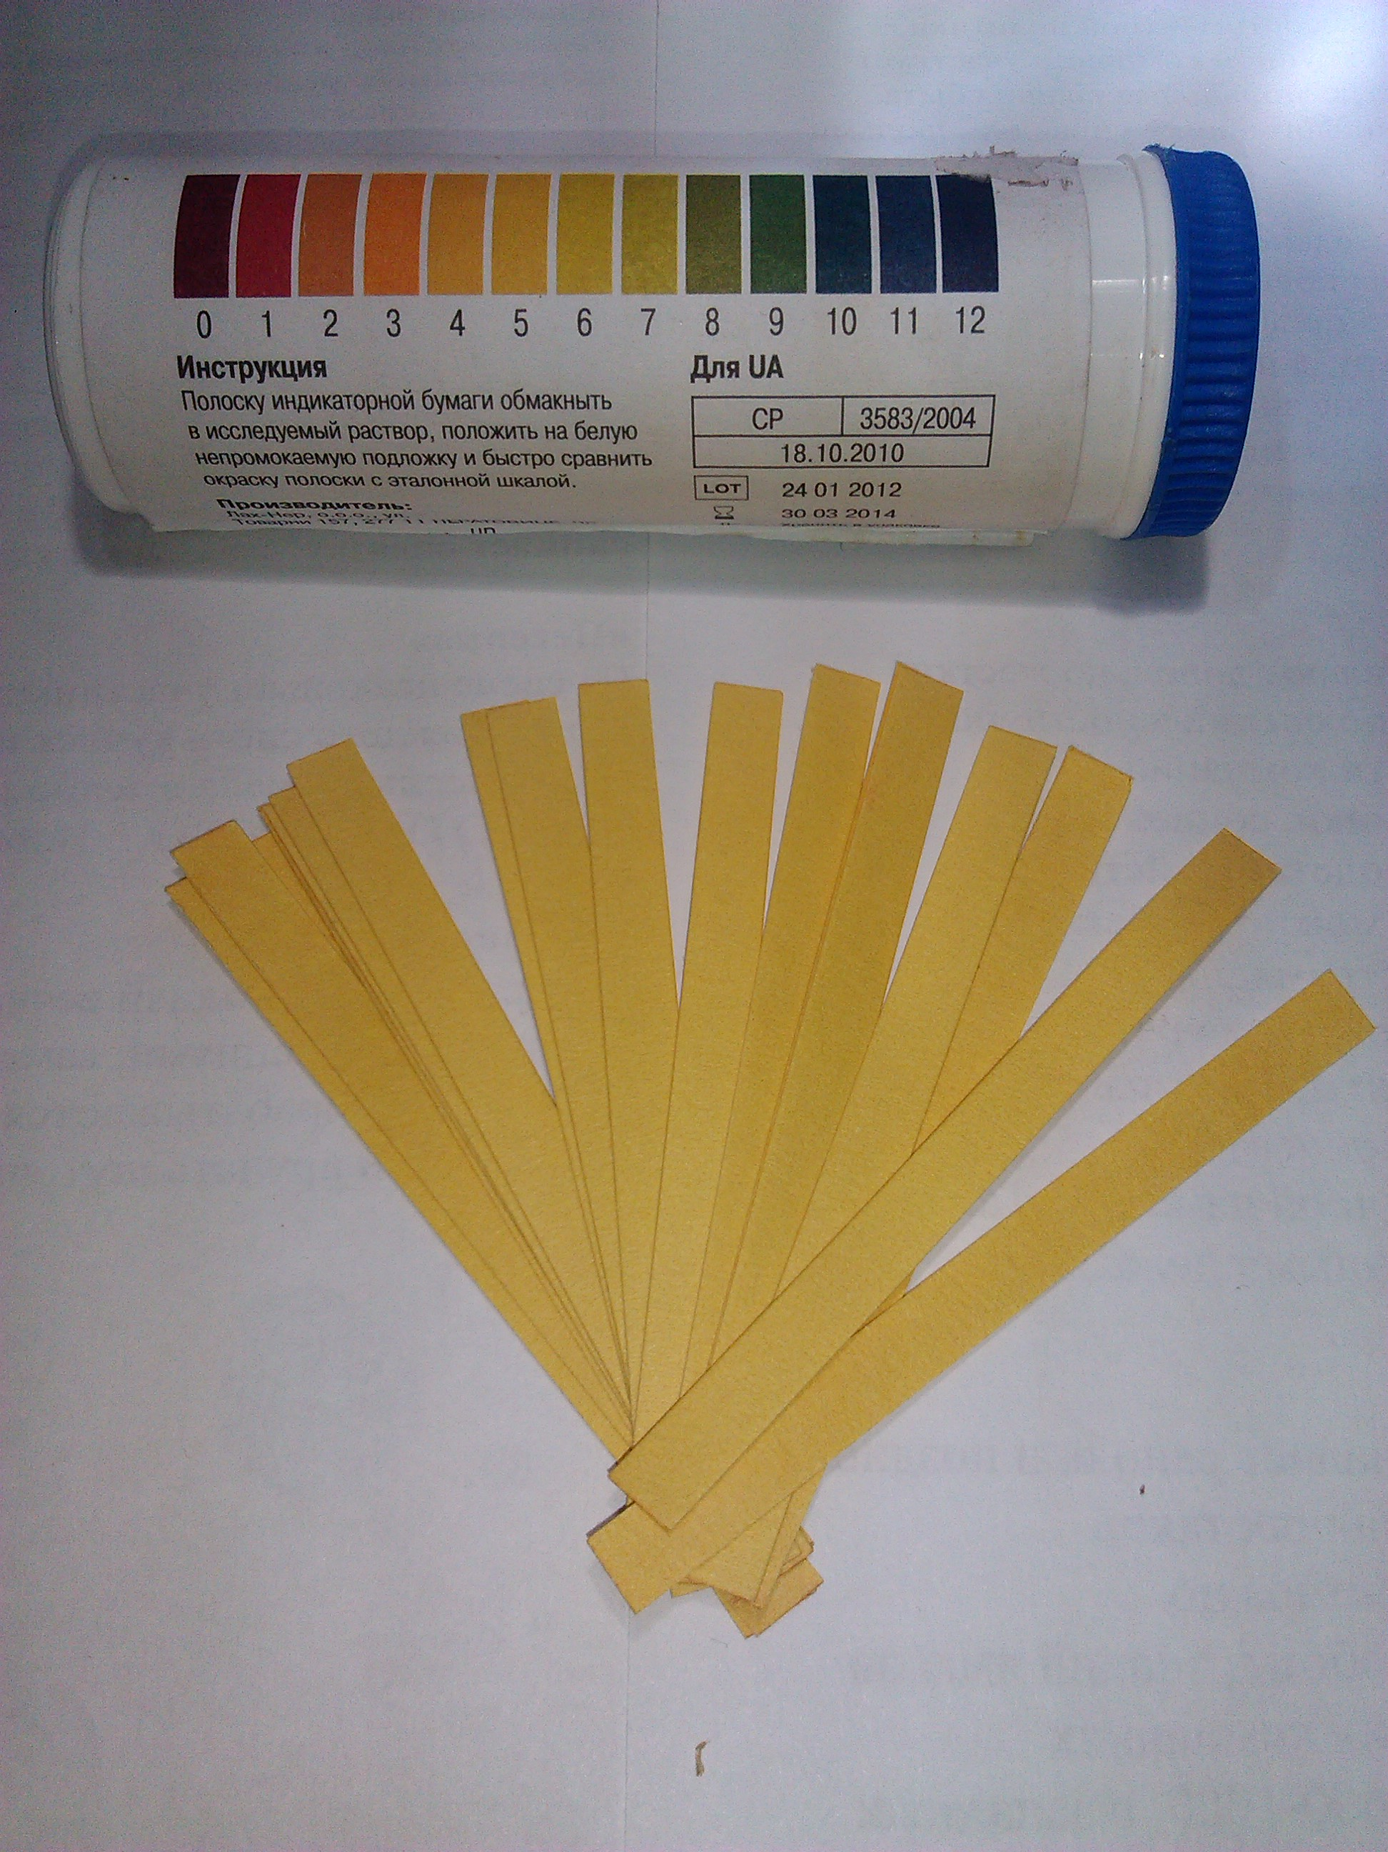

Air and water quality monitoring process
Air and water pollution can be analysed by using several methods.
There are three common forms of analysis – physical, chemical and biological. The temperature and content of the sample can be easily measured.
For example, the various gases or percentage of various gases, such as oxygen, nitrogen , carbon dioxide present in the air can be measured.
The PH value of the water can be measured through chemical analysis.
The microbial indicators used to monitor the health of the ecosystem.

Slide 4

Guidelines for Clean Air and Clean Water
Air pollution is mostly caused by production of the dust, mixture of solid particles and gases in the surrounding air. So avoid dust production , generation of solid particles and gases in the air.
Organisation must use limited number of vehicles to avoid air pollution. Practice a no vehicle day in every week.
The generation of ozone gas must be kept at low level by the organisation.
Most of the human activities pollute the surrounding water. Take care that their waste is not mixed with the surrounding water.
Extensive use of fertilizers and pesticide must be avoided as it can make the ground water polluted.

Slide 5
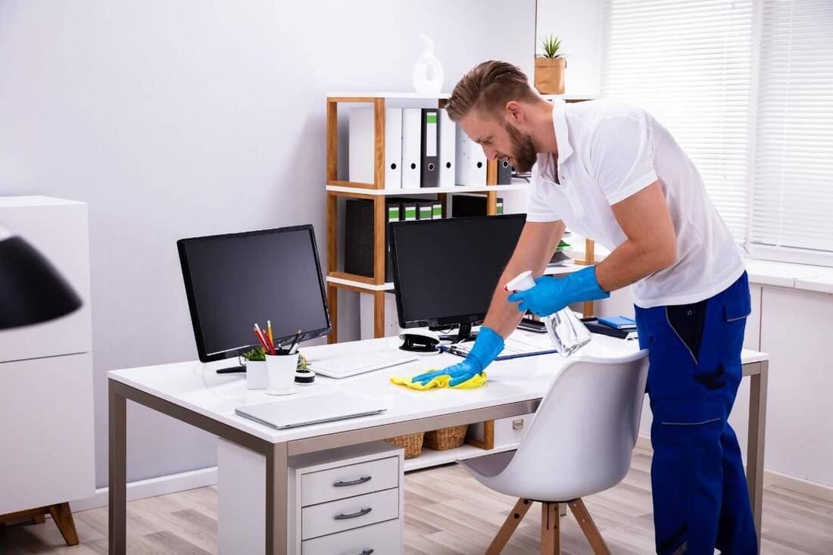
Importance of Cleanliness at Workplace
It is always safe to keep your workplace clean to avoid hazardous.
The poor handling and storage practices result in damages.
All areas must be kept neat and clean. Each employee is responsible for the cleanliness of their work area and all tools and equipment used.
Spills and breakage are to be cleaned up immediately.
Spaces around machines and equipment should be kept clear and clean at all times to permit free movement.
Floors should be kept clean and clear to prevent slipping and collision.

Slide 6
Office ergonomics
Ergonomics is the science concerned with designing and arranging things so that people can use them easily and safely
Early Warning Signs | Potential cause | Try this
Sore lower back | No lumbar support | Use back rest of chair, put small pillow or lumbar support on backrest of chair
Burning in the upper back | No upper back support from chair | Put document holder or prop up so you can see without leaning forward
Stiff neck | Working with head turned to side tilting head forward holding telephone between the ear and shoulder | Move or raise monitor to centre of desk check if headset is available
Dry eyes | Forget to blink | Rest eyes periodically and do simple eye exercises
Eye strain and sore eyes | Glares from overhead lights or windows eye glasses not correct need vision check | Re-orient your desk and computer so light is not directly behind or in front of you.

Slide 7
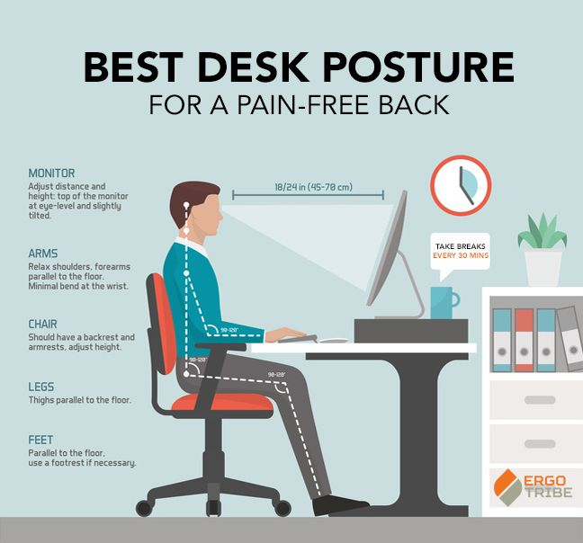
Musculoskeletal problem
This problem include different areas of your body, such as neck, back, chests, arms shoulders and feet. It occurs be cause of your wrong posture, uncomfortable chair for sitting ,etc. methods to avoid this are,
Position your computer such that the end of the monitor should be at your eye level.
Keep the neck neutral with monitor directly ahead to prevent to turn your neck.
Keep your monitor at least arm length distance ,or 20 to 30 inch away from you.
Adjust height of armrests so that your elbows are at a 100–110 degrees open angle.
While typing, keep your hands slightly lower than elbows, with fingers pointing downwards at the floor.

Slide 8
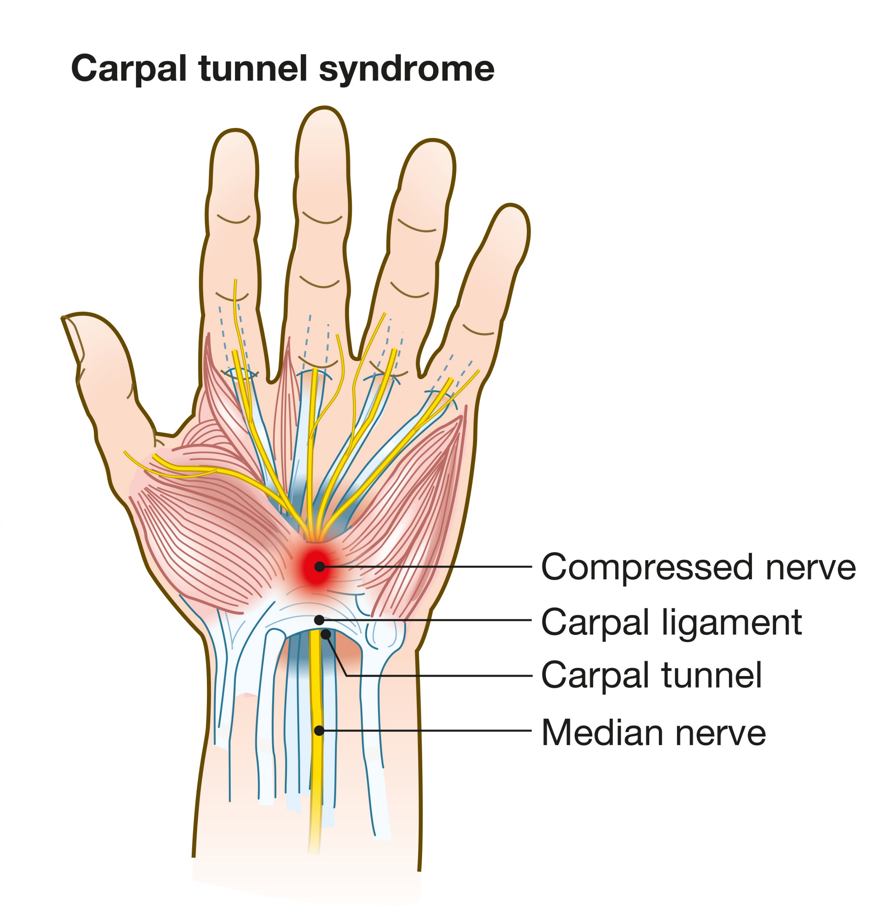
Occupational overuse syndrome
Occupational overuse syndrome, also known as repetition strain injury (RSI), is a collective term for a range of conditions, characterised by discomfort or persistent pain in muscles, tendons and other soft tissues, with or without physical manifestations.
Repetitive use of muscle may feel pain in your neck, shoulder, wrist or fingers
One of the most common conditions related to repetitive use of muscles when using the computer is carpal tunnel syndrome. It causes pain, numbness, and tingling in the hand and arm.
Ensure that you use appropriate posture when typing. For example, your fingers should be above the ‘home position’ (asdf and jkl; keys) on the keyboard, when your elbows are by your sides.

Slide 9
Examples of occupational overuse syndrome
Strain in Legs and Feet: Sitting to work for long time may cause strain in legs. Position your desk chair to sit comfortably with your feet flat on the floor and your lower legs vertical. Use a footrest for more support.
Eye Strain:Computer’s bright light, glare and flickering images can cause eye strain and visual fatigue. Computer Vision Syndrome is caused by poor lighting and glare on the computer screen. It is important to look after your eye health. Specifically wear anti-glare glasses to work on computer.
To reduce the risks of visual problems:
Adjust the brightness of computer screen to save your eyes from strain.
Reposition the screen to avoid glare from lights or windows.
Wear anti-glare glasses while working in computer.
Keep the screen clean and use a desk lamp to make it easier to see.

Slide 10

Other examples
Headaches: Headache may occur due to muscle tension or pain in the neck. Strain on the eyes or vision problem can also cause headaches. Attend regular eye exams to work toward correcting any vision problems.
Obesity: Spending long hours on computers may lead lacks of physical activity and exercise. In children prolonged use of computers or electronics in general, is a major contributing factor to obesity. You should take a break and try to squeeze in some exercise until you go back to work.
Sleeping Problems: Artificial lighting from computer screens can trick your brain and suppress its release of melatonin substance that assists your sleeping patterns. To tackle this , refrain from using a computer right before going to bed.

Slide 11
Health and safety requirements for computer workplace
The minimum health and safety requirements for computers including Desktop computers, Laptops,Tablets, Smart phones, Television screens and Video monitors are as follows:
Display Screen (Monitor): Use the modern LED monitors of legible size and with adequate spacing between the characters and lines. The image on the screen should be stable, with no flickering or other forms of instability.
Keyboard: The keyboard should tilt and separate from the screen to find a comfortable working position and avoid fatigue in the arms or hands.
Work Surface: The work desk should be sufficiently large, low reflectance surface and allow a flexible arrangement of the screen, keyboard, documents and related equipment.
Work Chair: The work chair must be stable and allow the user to move easily and find a comfortable position.

Slide 12
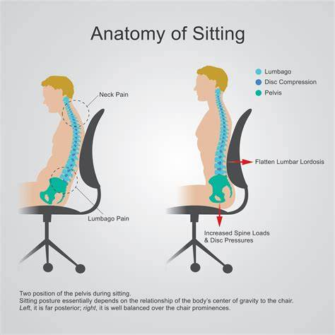
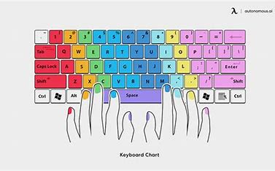
Other requirements
Space Requirements: The workstation should be designed to provide sufficient space for the user to change position and vary movements.
Lighting: There must be satisfactory lighting conditions with appropriate contrast between the screen and background environment.
Noise and Heat: Noise emitted by equipment should not distract the attention. Noise cancelling earphones may provide a solution if some noise is unavoidable. The equipment may produce excess heat which could cause discomfort to users.

Slide 13
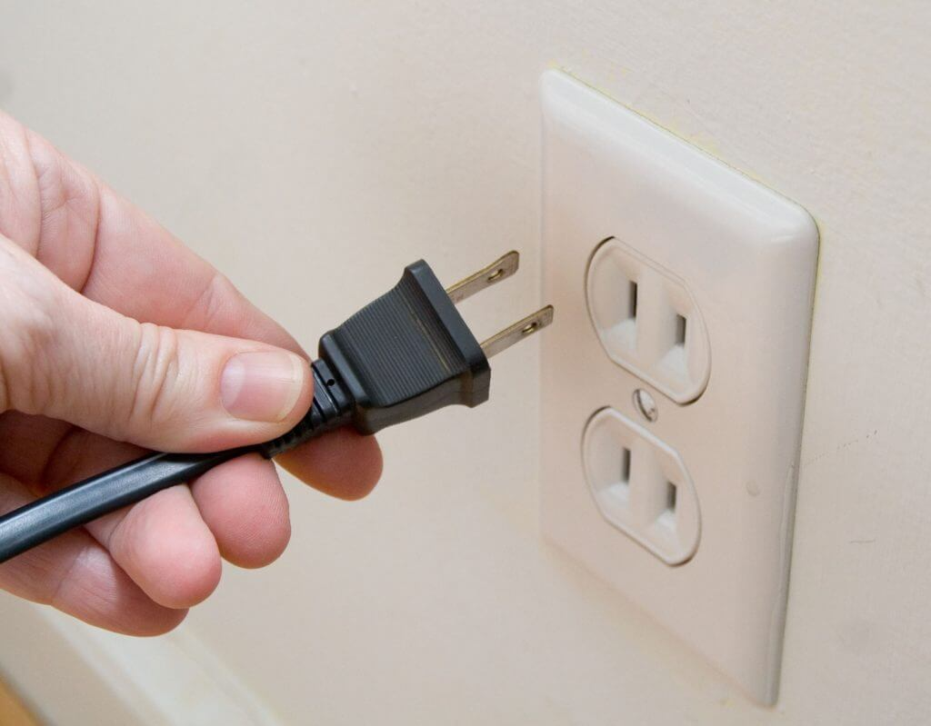
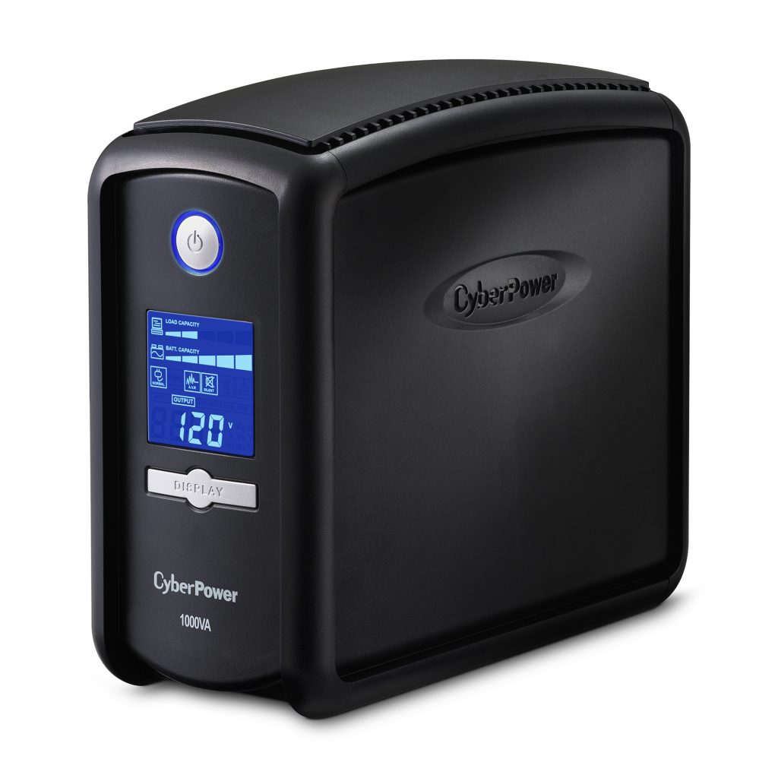
Cautions while working on the computer
It is important to work safely on computer. The static electricity generated just by walking on the carpet can damage your computer component.
A battery backup system is the best way to protect against a power outage, as it provides the system with constant voltage.
Remove rings, watches and necklaces while working on the computer. These ornaments are often made of conductive metals which can damage Computer components by striking them static electricity.
Unplug all power sources and cables from computer.

Slide 14
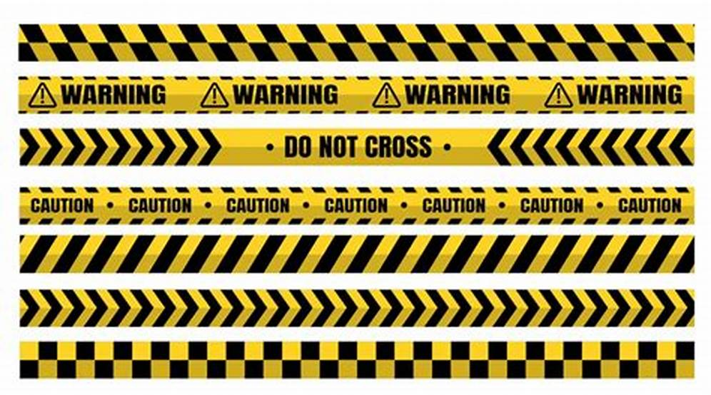
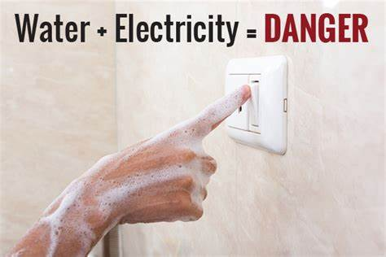
Watch out for cords and wires
Loose cords and wires can cause hazard and even electrical hazards.
If a cord or wire will cross a pathway safety it should be mark it with hazard tape as shown,
Avoid water at all times when working with electricity . Never touch or try repairing any electrical equipment or circuits with wet hands. It increases the electrical conductivity of the body for the flow of electric currents.

